Slide 1



Salesforce Solution for Interview Questions Picker Tool (Phase – 2)
Jan – 2021
PTG - SFDC
© 2020 YASH Technologies | www.yash.com | Confidential

Slide 2

Agenda
Interview Questions Picker Tool
Context
Scope
Requirements/Features
WBS (Work Breakdown Structure) Details
Show and Tell Timeline
Design Architecture

Slide 3
Context
Yash Salesforce Team has developed Interview Questions Picker Tool which automates the process of preparing a Unique Questions during interview process.
The Interview is a conversation in which you and an employer exchange information. This makes one’s organization Interview Process in a difficult and obsolete the whole concept of repeating the questions to the candidates.
Interviewing is an important step in the employee selection process. If done effectively, the interview enables the employer to determine if an applicant's skills, experience and personality meet the job's requirements.
It also helps the employer assess whether an applicant would likely fit in with the corporate culture.

Slide 4
Scope
This Interview Question Picker tool will be helpful for every organization in hiring process.
It helps in recruiting quality candidates by having unique set of questions for every individual candidate.

Slide 5
Requirements/Features
Handling multiple select topics request at a single instance.
Create an automation using email to case.

Slide 6
WBS (Work Breakdown Structure) Details
Story No | Developer | Requirement/Feature | Sprint | Priority | Tasks | Progress | Start Date | End Date
QPT-0001 | Mallesh | Handling multiple select topics request at a single instance. | Sprint – 2 | High |  | Not Started

Slide 7
Show and Tell Timeline
Demo’s check with (Mitesh Sharma, Ravi Dhote):
12, Feb 2021 (Demo 1st version of Phase 2)

Slide 8
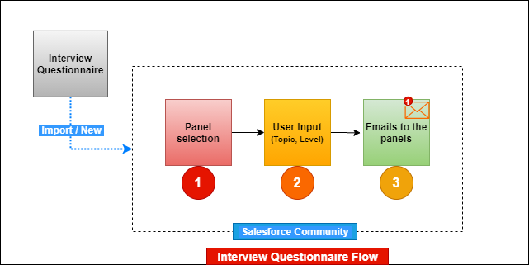
Design Architecture

Slide 9
THANK YOU

